Slide 1
Gene pathway analysis:
Theory and Hands on training
Yong Liu, Ms, PhD
yoliu@mcw.edu
4149554297
04/03/23
https://github.com/yliuphys/Pathway-analysis-hands-on-training-2023-spring

Slide 2
Major tools for pathway analysis
Free tools:
GSEA (Windows/Mac/Linux software)
DAVID (online tool)
R packages: fgsea (GSEA analysis with R), goseq (gene ontology enrichment analysis with R), clusterProfiler (KEGG pathway enrichment analysis with R), et al.,
Commercial tool:
IPA (Ingenuity Pathway Analysis) by Qiagen

Slide 3

Pathway analysis using Gene Set Enrichment Analysis (GSEA)
Website:
https://www.gsea-msigdb.org/gsea/index.jsp
Software download:
http://www.gsea-msigdb.org/gsea/login.jsp
User guide:
https://www.gsea-msigdb.org/gsea/doc/GSEAUserGuideFrame.html
Original publication:
https://www.pnas.org/content/102/43/15545

Slide 4
What GSEA can do?
Identifies sets of genes that are enriched in a particular dataset (e.g., pathway) when compared to a control.
Unlike Gene Ontology, it does not consider only the subset of gene with significant changes in gene expression. Instead, it considers the changes in gene expression of all genes in the dataset.
The GSEA analysis can help us find the biological cluses from our RNA-seq or microarray data.

Slide 5
How the GSEA works:
Works on gene sets (pathways et al.). Created based on our available biological knowledge.
Rank genes list (data set) by a suitable metric.
Compute an Enrichment Score (ES) for each data set. The ES tells you the degree to which this gene set is overrepresented at the top or bottom of the ranked list of genes in the dataset.
Generate null distribution & compute p & q values for gene sets by permutation. It gives you the statistical significance of enrichment score. The q value is the one you use to filter on.
Gene set enrichment analysis: A knowledge-based approach for interpreting genome-wide expression profiles. Subramanian et al 2005, PNAS, 102 (43) 15545-15550

Slide 6
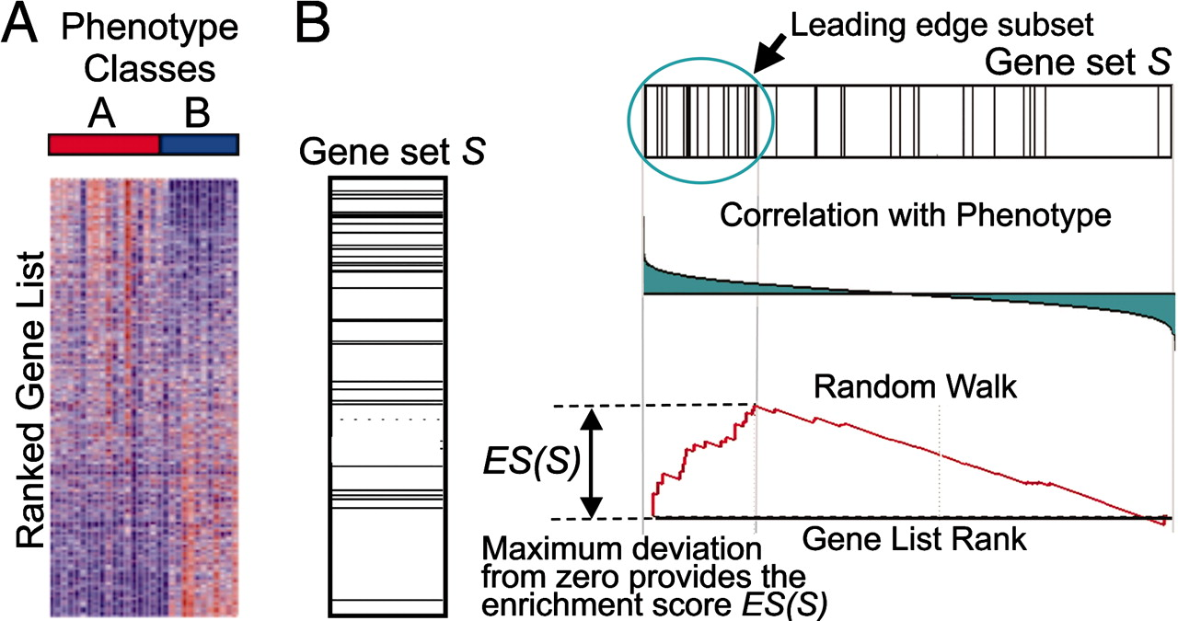
An overview of GSEA method
Subramanian et al. PNAS 2005

Slide 7
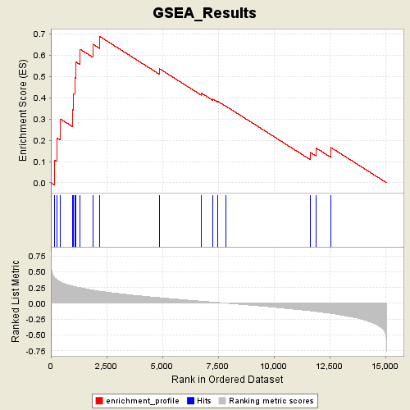
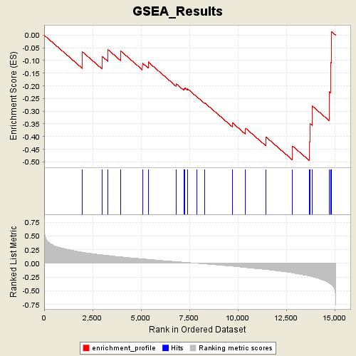
Gene set can enrich in two directions

Slide 8
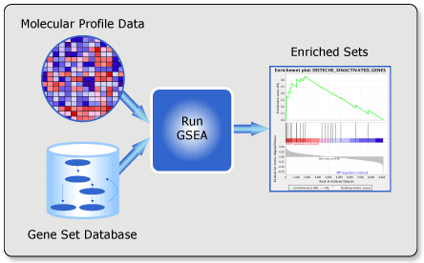
To run GSEA, you will need:
Software to run the analysis.
Data set: a gene expression dataset in GCT/TXT format & the corresponding sample annotations in CLS format
Gene sets: a collection of gene sets in GMX/GMT/GRP format
Setting of parameters

Slide 9

Data format for Data set and Gene set
http://www.gsea-msigdb.org/gsea/doc/GSEAUserGuideFrame.html
Expression datasets: .gct
Phonotype dataset: .cls
Mind the autocorrect by excel for the gene name:
https://www.nature.com/articles/d41586-021-02211-4
e.g. human SEPT3 gene will be autocorrected to 3-sep. Either manually change to new gene name (SEPTIN3) or use ‘SEPT3 in excel to avoid autocorrection.

Slide 10
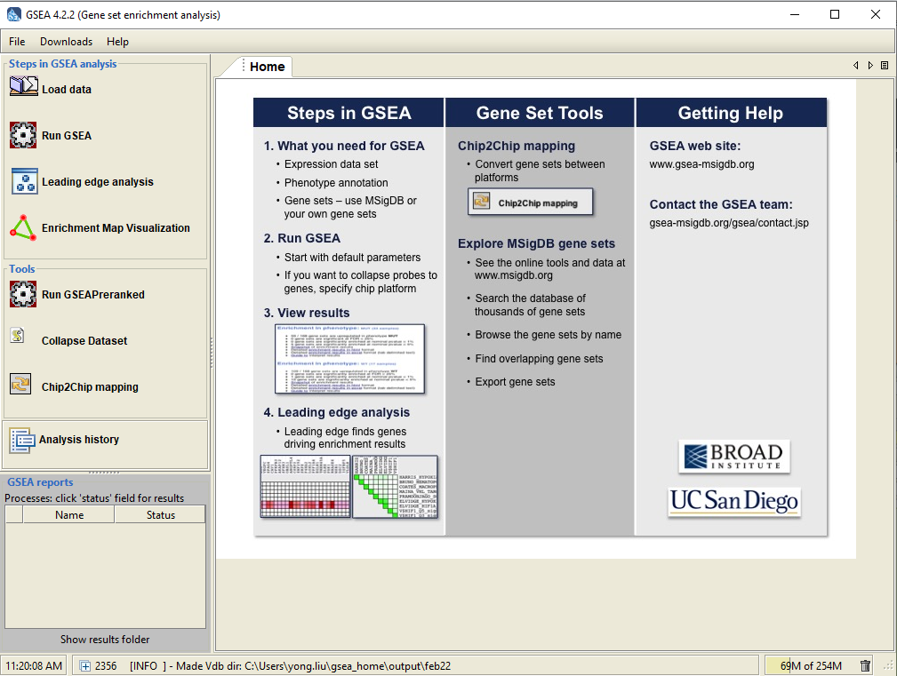
Two ways to run GSEA with RNA-seq data
Run GSEA:
Input: DEseq2 normalized read counts
Run GSEA Pre-ranked:
Input: DEseq2 shrunken logFC
*logFC: log(2) fold change
**the lower expressed genes usually have high variability, and the shrinkage can reduce it
Notes:
Gene expression levels are heavily skewed in linear scale: half of the data-point (the lower expressed genes) are between 0 and 1 (with 1 meaning no change), and the other half (the higher expressed genes) between 1 and positive infinity. Consider the case where the normalized expression levels are 0.1 (A), 1 (B) and 10 (C) for 3 samples (A-C) under study. Intuitively, we understand that sample A has a ten-fold lower expression compared to sample B, and that C has a ten-fold higher expression compared to B. However, in linear scale A and B are much closer (similar) to each other than B and C (0.9 units versus 9 units). A parametric statistical test will therefore be biased and not appreciate that A and C are equally different from B. Upon log transformation (I use base 10 here, but any base will do), the distance between A and B, and between B and C becomes equal (1 log10 unit, as the log10 values of A, B, and C are -1, 0 and 1). Log transformation makes your data more symmetrical and therefore, a parametric statistical test will provide you with a more accurate and relevant answer.

Slide 11
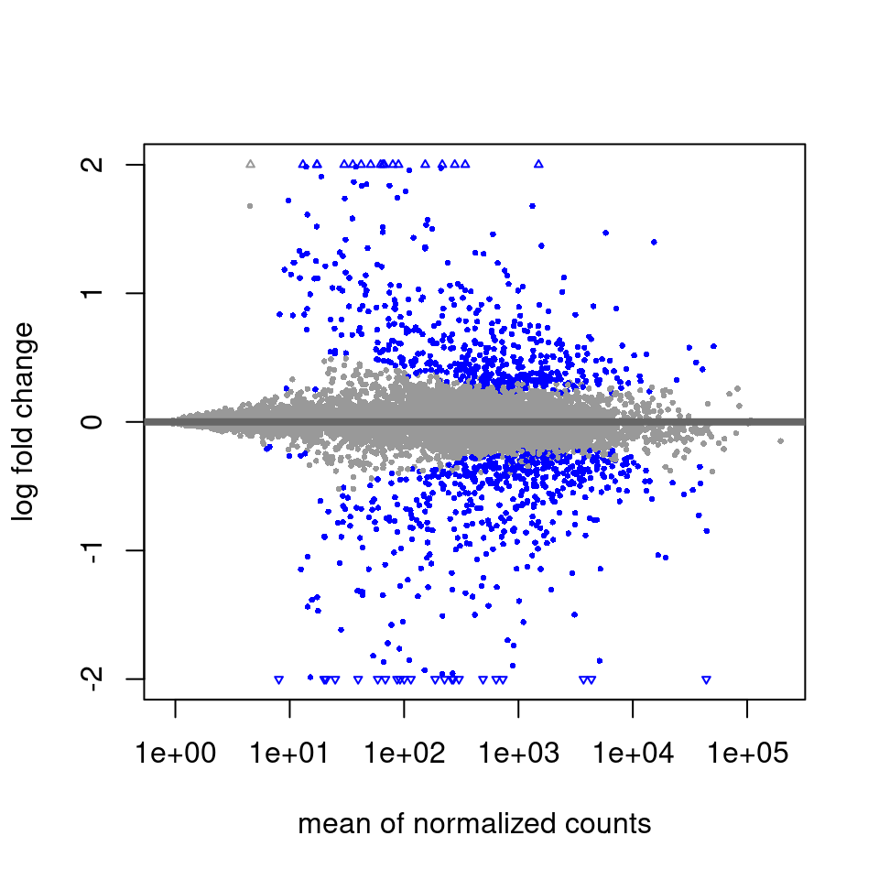
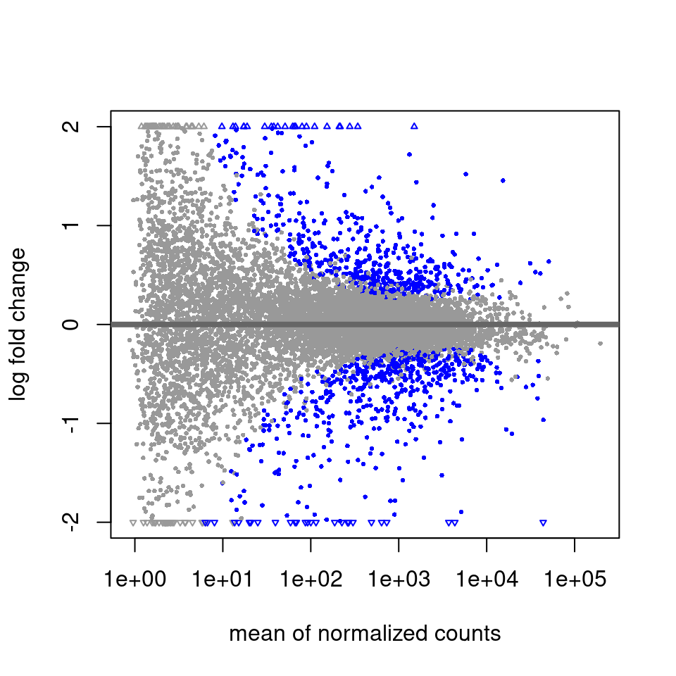
Run GSEA Pre-ranked:
Input: DEseq2 shrunken logFC
Shrink the log(fold-change) genes with high noise
shrinkage
DESeq2 command for shrink logFC: lfcShrink()
http://bioconductor.org/packages/devel/bioc/vignettes/DESeq2/inst/doc/DESeq2.html

Slide 12
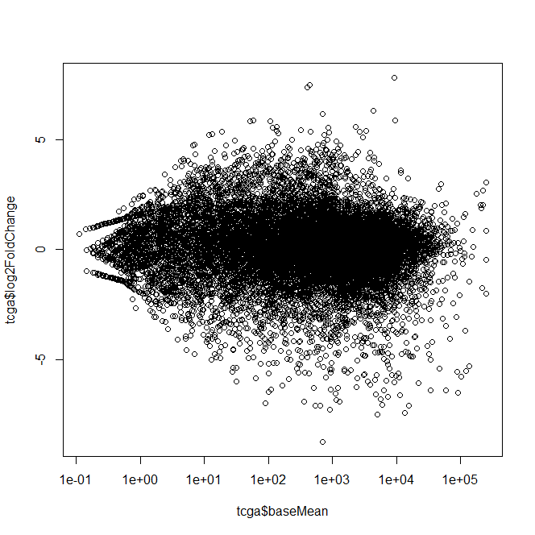
Newer version (> v1.16) of DEseq2 results:
logFC has already been shrunked
* Need plot to check

Slide 13
Create your own ranked gene list based on processed RNA-seq data
the ranked DEG list (s_{i} = sign(fold change gene i) × (−log₁₀(P_{i})): https://www.nature.com/articles/s41467-020-18985-6
R generateGSEA() function use abs(stat)*log2FoldChange for ranking: https://rdrr.io/github/kevincjnixon/BinfTools/man/GenerateGSEA.html
A “typical” results from DEseq2

Slide 14
Working with none-human dataset
*MsigDB only collect human genes. In order to run GSEA for none-human dataset, we can do
Convert our dataset to human homology gene dataset
1): download a chip file from Broad institute that contains a translation table from mouse/rat to human(https://data.broadinstitute.org/gsea-msigdb/msigdb/annotations_versioned/Mouse_ENSEMBL_Gene_ID_to_Human_Orthologs_MSigDB.v7.1.chip)
Probe Set ID Gene Symbol Gene Title
ENSMUSG00000000001 GNAI3 G protein subunit alpha i3 [Source:HGNC Symbol;Acc:HGNC:4387]
ENSMUSG00000000028 CDC45 cell division cycle 45 [Source:HGNC Symbol;Acc:HGNC:1739]
ENSMUSG00000000037 SCML2 Scm polycomb group protein like 2 [Source:HGNC Symbol;Acc:HGNC:10581]
Or https://data.broadinstitute.org/gsea-msigdb/msigdb/annotations_versioned/Mouse_Gene_Symbol_Remapping_Human_Orthologs_MSigDB.v7.5.1.chip
NPR-A NPR1 natriuretic peptide receptor 1 [Source:HGNC Symbol;Acc:HGNC:7943]
NPRA NPR1 natriuretic peptide receptor 1 [Source:HGNC Symbol;Acc:HGNC:7943]
Nprap CTNND2 catenin delta 2 [Source:HGNC Symbol;Acc:HGNC:2516]
NPR-C NPR3 natriuretic peptide receptor 3 [Source:HGNC Symbol;Acc:HGNC:7945]
2): use Ensembl Biomart online tool (http://useast.ensembl.org/biomart/martview/3d358ef80ac985f1250e8f3d3f6d8a39) to download the translation table. For example:
Select “Ensembl Genes 105” and “Mouse genes (GRCm39)”
In the menu on the left, select “Attributes”
Then “Homologues” and “Orthologues [F-J]:” and scroll down to “Human Othologues”
Check “Human gene stable ID” and “Human gene name”
Click the “GENE”, select the mouse gene information you want to included, such as “Gene name”
Go to top left “Results” and download the translation table.
Convert MsigDB gene sets to none human homology gene sets: less likely to choose
For mouse: https://bioinf.wehi.edu.au/software/MSigDB/
Or use R package of: https://cran.r-project.org/web/packages/msigdbr/vignettes/msigdbr-intro.html

Slide 15
Demo or hands on training
Practice on RNA-seq data set:
The data are from the The Cancer Genome Atlas (TCGA) project and comprise the RNA-seq counts from 5 breast cancer patients and 5 healthy individuals.
https://raw.githubusercontent.com/sheffield-bioinformatics-core/rna-seq-in-galaxy/gh-pages/tcga_raw_counts.csv
How to get a normalized count data for GSEA input:
https://software.broadinstitute.org/cancer/software/gsea/wiki/index.php/Using_RNA-seq_Datasets_with_GSEA
Use gene pattern https://cloud.genepattern.org/gp/pages/index.jsf with DESeq2 module to run the source count data (make sure to create .gct and .cls file).

Slide 16
Steps to run GenePattern
https://cloud.genepattern.org/gp/pages/index.jsf
1: Create a folder under “Files” to save the source data files: “Files”, “uploads”, and then “Create Subdirectory”.
2: load the .gct and .cls files to the created folder: click the folder you just created, “Upload Files”, select both of the .gct and .cls files from ...\Pathway-analysis-hands-on-training-2023-spring-main\GenePattern\Input_files, select “open”, select the folder you just created, hit “select”. If you see two “complete!”, close the pop-up window.
3: Under “Modules”, click “Browse Modules” , select “differential expression”, select “DESeq2”.
4: under “input file”, drag the .gct file from your created folder (if you can not find file, go to “Files” and select the folder you just created).
5: under “cls file”, drag the .cls file from your created folder.
6: change the “random seed” to 100 so that we can reproduce the results.
7: keep other parameters unchanged.
8: hit “RUN” at bottom right and wait.

Slide 17
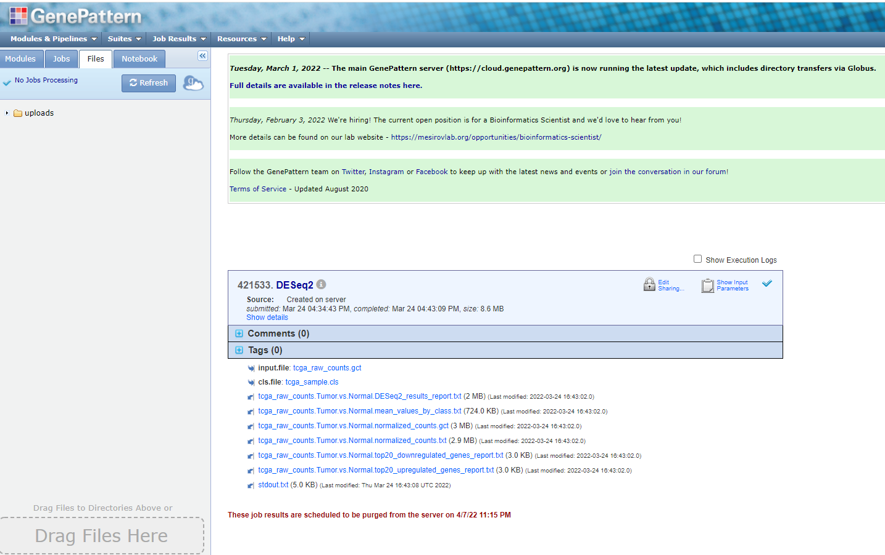
Results from GenePattern
This .cls file will be used for GSEA analysis. Mind it is one of our input file to run GenePattern
This file can be used for GSEA analysis with pre-ranked method
This file will be used for GSEA analysis

Slide 18
Steps to run GSEA
1: “Load data”, “Method 1:”, “Browse for files”, load the .gct file (from GenePattern) and .cls file (used for run GenePattern). Make sure the pop-up window show “There were NO errors”. Click “OK”.
*the two files can also get from ...\Pathway-analysis-hands-on-training-2023-spring-main\GSEA\GSEA_input_files
2: “Run GSEA”. “Expression dataset”, select the .gct file you just loaded.
3: “Gene sets database”, select the top one “...Hallmarks”. Click “OK”.
4: “number of permutations” can keep default setting as 1000.
5: “phenotype labels”, select “tumore vs normal”. This will impact your final annotation of the GSEA results.
6: “Collapse/Remap to gene symbols”, select “No_Collapse”.
7: “Permutation type”, if less than 7 samples per group, select “gene_set”. If more than 7 samples per group, you can select either “phenotype” or “gene_set”. As we only have n=5, so please only select “gene_set”.
8: Under “Basic field”, you can name your analysis and change the folder that you used to keep your results.
9: Hit “Run” at bottom right and wait. Watch “GSEA reports” at bottom left for any errors.
10: if no error, click green “Success” at “GSEA reports” at bottom left for results.

Slide 19
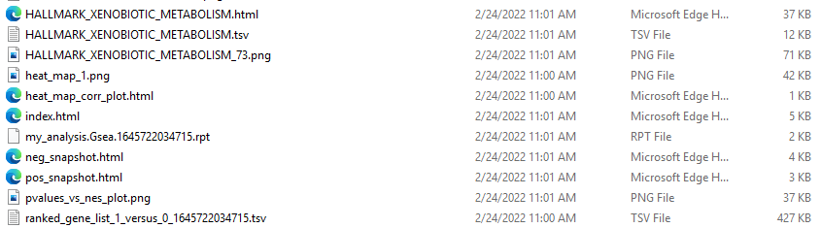
Results from GSEA
In output folder:

Slide 20
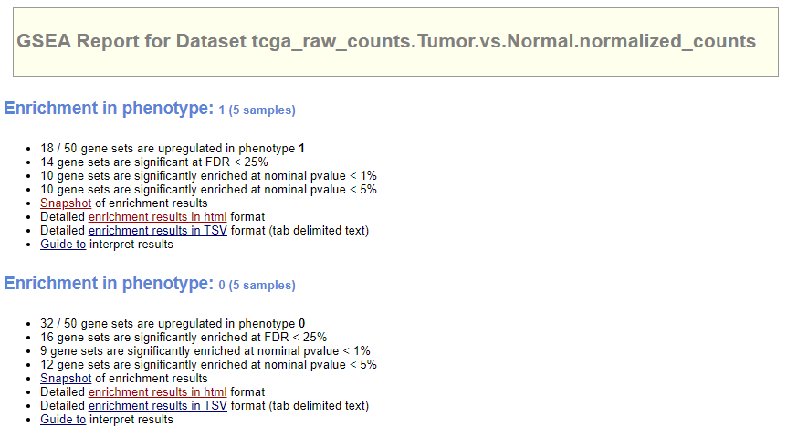

Slide 21
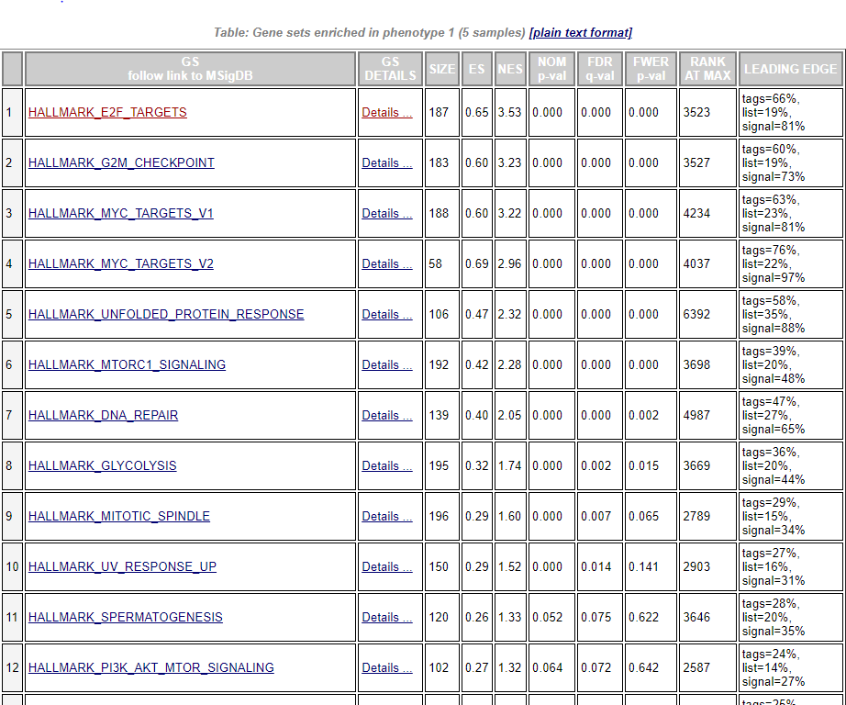
Number of genes in the gene set
Enrichment score (maximum peak in the enrichment plot graph)
Nominal P value (looking data within one gene set on how likely this gene set is significant)
Enrichment results details including score and plot
Tag is percentage of genes in the gene set before the peak.
List is the percentage of your list of gene at the leading edge
Hyperlink to gene set website
For you list of genes (ranked), which gene is at the peak
Not use anymore
False discovery rate q value (for those gene set that is significant (NOM p-val), what is the chance of the significant is false positive). Usually, the cutoff is 0.25.
Normalized enrichment score (enrichment score normalized by gene set size): better comparison between gene set

Slide 22

Database for Annotation, Visualization and Integrated Discovery (DAVID)
An Online Tool
DAVID determined overlaps between user-supplied gene lists and the curated databased, looking for overlaps that are bigger than expected by random chance. The user-supplied gene sets are normally generated by selecting genes that pass a significance threshold, such as FDR adjusted p< 0.05.
Website:
https://david.ncifcrf.gov/
* Newly updated on 2021q4 for Entrez gene and uniport, but ENSEMBL still using 2016 version
Tutorial:
https://david.ncifcrf.gov/helps/tutorial.pdf

Slide 23
Fisher’s exact test that DAVID applied:
Limitation:
Arbitrary cutoff for DE gene list
Quantitative gene expression information was not used
Assume independence among genes

Slide 24
Demo or hands on training
https://david.ncifcrf.gov/

Slide 25
Steps to run DAVID
1: selected a group of genes based on results from DESeq2 (…DESeq2_results_report.txt from GenePattern with DESeq2 module). Usually filter genes first based on padj less than 0.05. You can then further filter gene list by absolute value of log2FoldChange. A list of couple of hundreds gene is a good number to run DAVID.
2: https://david.ncifcrf.gov/
3: “Start Analysis”, “Upload”, copy and paste gene names to “step1: Enter Gene List” “A: Paste a list”.
4: “step 2: select identifier”, select “OFFICIAL_GENE_SYMBOL”.
5: “step 2a: Select species”, please type in “Homo sapiens”.
6: “step 3: list type”, please select “gene list”.
7: “step 4 submit list”, hit “Submit List”.
8: for results, please click “Functional Annotation Tool”, select “Pathways”, click “Chart” of the “KEGG_PATHWAY” to check.

Slide 26
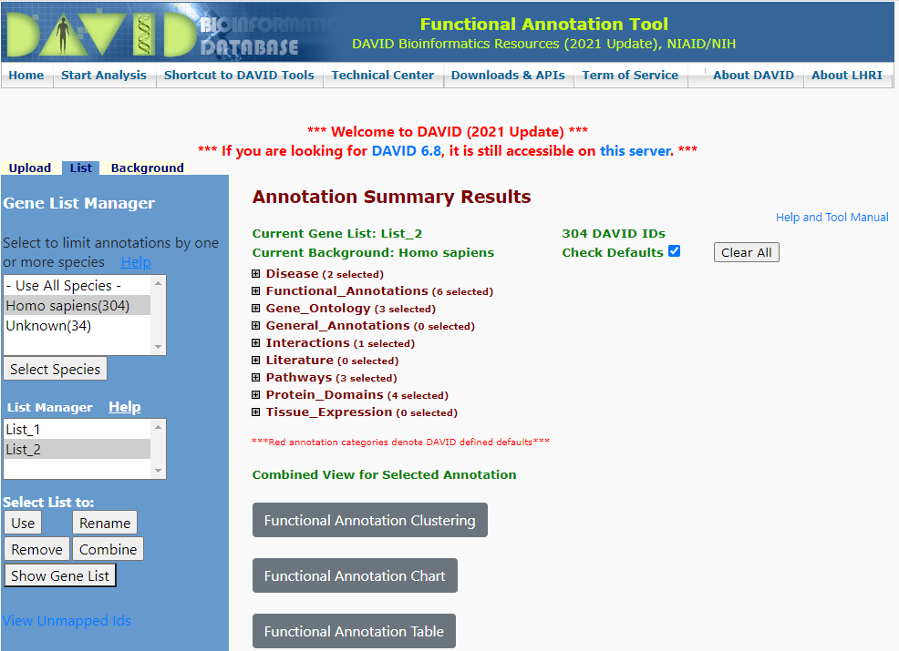
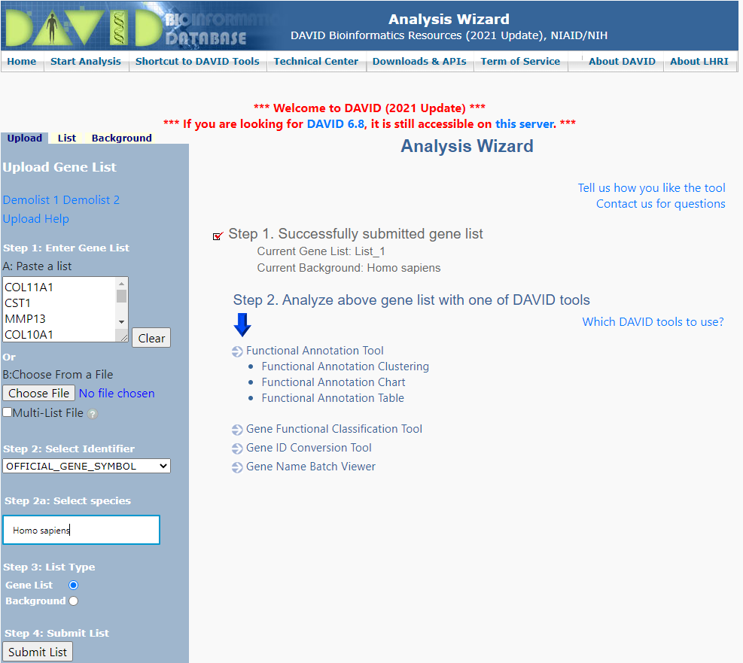
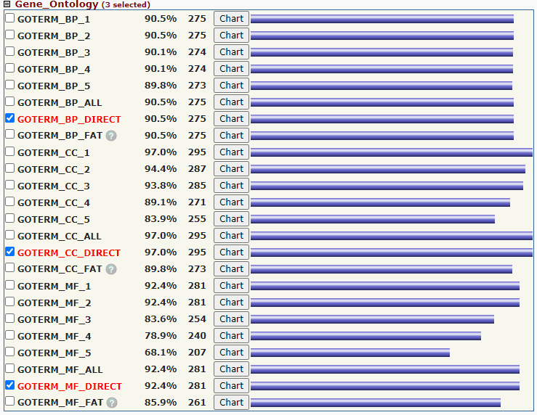
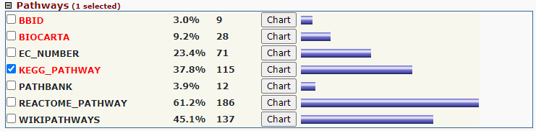
DAVID: data input
results
BP: biological processes
CC: cellular components
MF: molecular functions

Slide 27
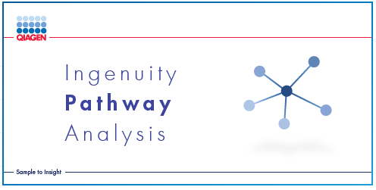

Company maintained, actively updated.
Not only identify significant pathway (similar to DAVID) but can also tells you whether the pathway is predicted to be activated or inhibited based on your data.
Can identify upstream regulators based on the downstream effects (your data), which will help you to develop actionable hypotheses.
and more…. (https://digitalinsights.qiagen.com/news/blog/discovery/the-secrets-to-pathway-analysis/)

Slide 28
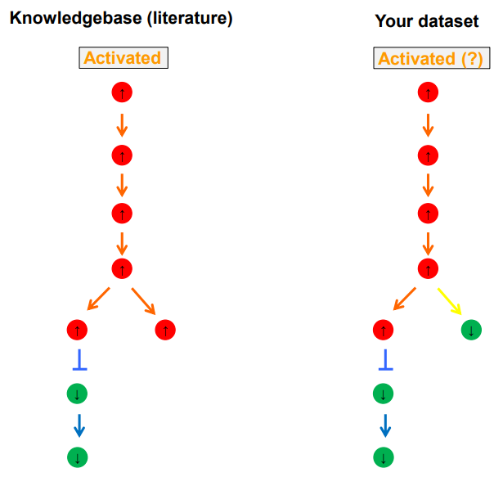
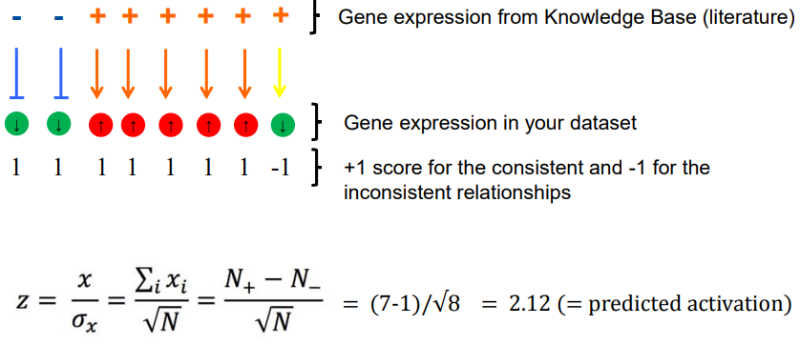
The statistics of IPA analysis:
IPA calculates two distinct statistics as part of a core analysis
Overlapping P-value:
Calculated using a Fisher’s Exact Test
The statistical test looks for an unexpectedly large overlap given the number of molecules in each category. The smaller the p-value the less likely that the association is random.
The p-value does not consider the directional effect of one molecule on another, or the direction of change of molecules in the dataset.
Z-score:
A z-score represents the non randomness of directionality of a gene set and within a gene set. Z-score thus provide a measurement of the direction of change.
Z-score >2 or <-2 is considered significant

Slide 29
Demo or hands on training

Slide 30
GSEA, DAVID, and IPA
 | approach | analysis | test | input data | pro | con
GSEA | continuous | GSEA (gene set enrichment analysis) | Kolmogorov-Smironov | the whole gene list that ordered | consider all genes, less bias | time and resources consuming
DAVID | discrete | ORA (over representation analysis) | Fisher's exact | a selected gene list, e.g. DE gene with a FDR rate threshold | Quick and easier | can be very arbitrary
IPA | discrete | ORA with Z score for direction of change | Fisher's exact | a selected gene list with various type of value | can provide directional enrichment analysis, more function | not free, can be very arbitrary

